Slide 1
Decoder and Encoder
Dr. Manju Khurana
Assistant Professor, CSED
TIET, Patiala
manju.khurana@thapar.edu

Slide 2
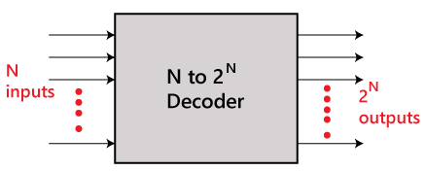
Decoder
The combinational circuit that change the binary information into 2^{N} output lines is known as Decoders. The binary information is passed in the form of N input lines. The output lines define the 2^{N}-bit code for the binary information. In simple words, the Decoder performs the reverse operation of the Encoder. At a time, only one input line is activated for simplicity. The produced 2^{N}-bit output code is equivalent to the binary information. There are various types of decoders which are as follows:

Slide 3
2 to 4 line Decoder
In the 2 to 4 line decoder, there is a total of three inputs, i.e., A₀, and A₁ and E and four outputs, i.e., Y₀, Y₁, Y₂, and Y₃. For each combination of inputs, when the enable 'E' is set to 1, one of these four outputs will be 1. The block diagram and the truth table of the 2 to 4 line decoder are given below.

Slide 4
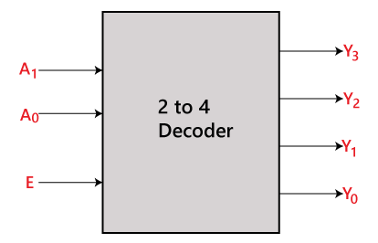
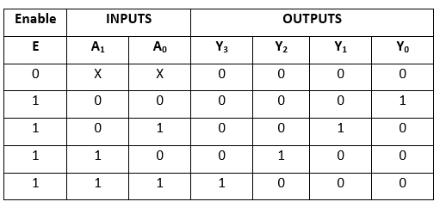
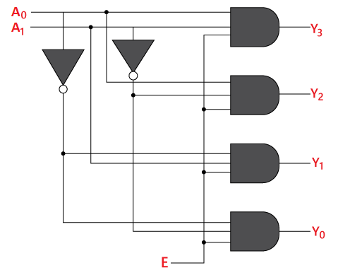
2 to 4 line Decoder
Block Diagram:
Truth Table:
Logical circuit:
The logical expression of the term Y₀, Y₁, Y₂, and Y₃ is as follows:
Y₃=E.A₁.A₀ Y₂=E.A₁.A₀‘
Y₁=E.A₁'.A₀ Y₀=E.A₁'.A₀'

Slide 5
3 to 8 line decoder
The 3 to 8 line decoder is also known as Binary to Octal Decoder. In a 3 to 8 line decoder, there is a total of eight outputs, i.e., Y₀, Y₁, Y₂, Y₃, Y₄, Y₅, Y₆, and Y₇ and three inputs, i.e., A₀, A1, and A₂. This circuit has an enable input 'E'. Just like 2 to 4 line decoder, when enable 'E' is set to 1, one of these four outputs will be 1. The block diagram and the truth table of the 3 to 8 line encoder are given below.

Slide 6
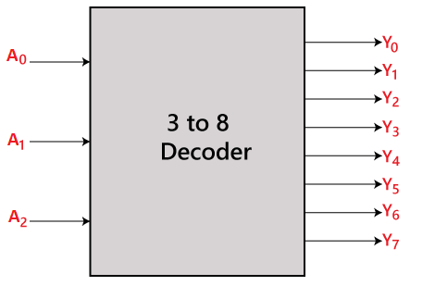
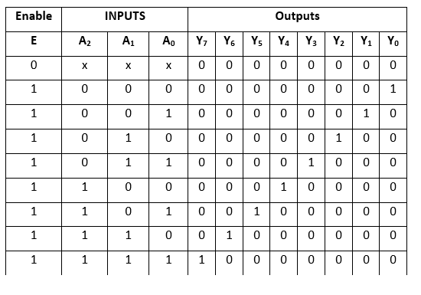
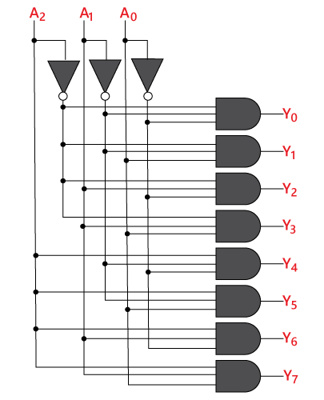
3 to 8 line decoder
Block Diagram:
Truth Table:
Logical circuit:
E
The logical expression of the term Y₀, Y₁, Y₂, Y₃, Y₄, Y₅, Y₆, and Y₇ is as follows:
Y₀=A₀'.A₁'.A₂’ Y₁=A₀.A₁'.A₂’ Y₂=A₀'.A₁.A₂’ Y₃=A₀.A₁.A₂’ Y₄=A₀'.A₁'.A₂ Y₅=A₀.A₁'.A₂ Y₆=A₀'.A₁.A₂ Y₇=A₀.A₁.A₂

Slide 7
4 to 16 line decoder
In the 4 to 16 line decoder, there is a total of 16 outputs, i.e., Y₀, Y₁, Y₂,……, Y₁₆ and four inputs, i.e., A₀, A1, A₂, and A₃. The 3 to 16 line decoder can be constructed using either 2 to 4 decoder or 3 to 8 decoder. There is the following formula used to find the required number of lower-order decoders.
Required number of lower order decoders=m₂/m₁
m₁ = 8 m₂ = 16
Required number of 3 to 8 decoders= =2

Slide 8
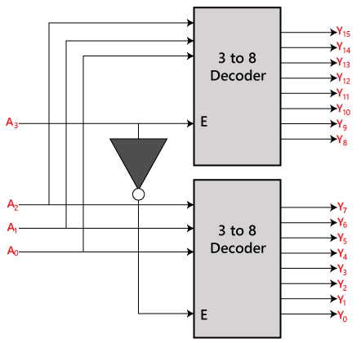
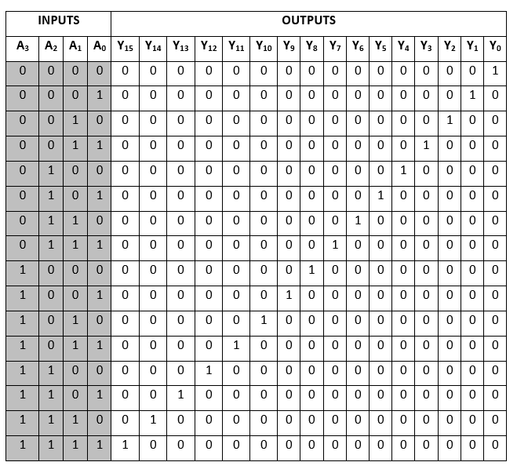
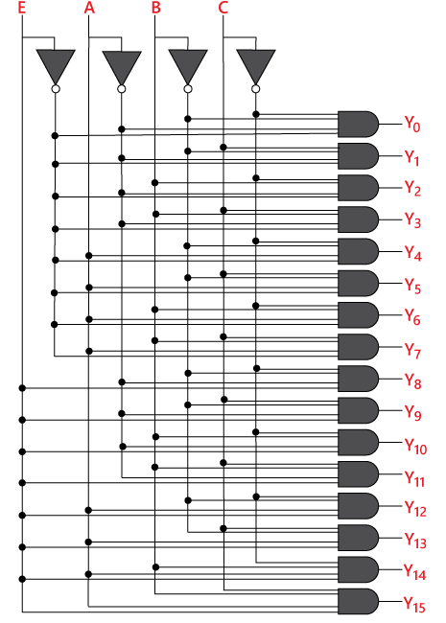
4 to 16 line decoder
Block Diagram:
Truth Table:
Logical circuit:
The logical expression of the term Y₀, Y₁, Y₂,…, Y₁₅ are as follows:
Y₀=A₀'.A₁'.A₂'.A₃’ Y₁=A₀'.A₁'.A₂'.A₃ Y₂=A₀'.A₁'.A₂.A₃‘ Y₃=A₀'.A₁'.A₂.A₃ Y₄=A₀'.A₁.A₂'.A₃‘ Y₅=A₀'.A₁.A₂'.A₃ Y₆=A₀'.A₁.A₂.A₃‘ Y₇=A₀'.A₁.A₂.A₃ Y₈=A₀.A₁'.A₂'.A₃‘ Y₉=A₀.A₁'.A₂'.A₃ Y₁₀=A₀.A₁'.A₂.A₃‘ Y₁₁=A₀.A₁'.A₂.A₃ Y₁₂=A₀.A₁.A₂'.A₃‘ Y₁₃=A₀.A₁.A₂'.A₃ Y₁₄=A₀.A₁.A₂.A₃' Y₁₅=A₀.A₁.A₂'.A₃

Slide 9
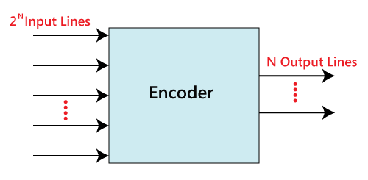
Encoder
The combinational circuits that change the binary information into N output lines are known as Encoders. The binary information is passed in the form of 2^{N} input lines. The output lines define the N-bit code for the binary information. In simple words, the Encoder performs the reverse operation of the Decoder. At a time, only one input line is activated for simplicity. The produced N-bit output code is equivalent to the binary information. There are various types of encoders which are as follows:

Slide 10
4 to 2 line Encoder
In 4 to 2 line encoder, there are total of four inputs, i.e., Y₀, Y₁, Y₂, and Y₃, and two outputs, i.e., A₀ and A₁. In 4-input lines, one input-line is set to true at a time to get the respective binary code in the output side. Below are the block diagram and the truth table of the 4 to 2 line encoder.

Slide 11
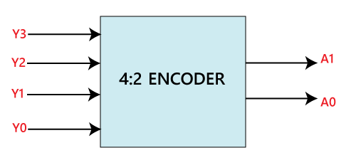
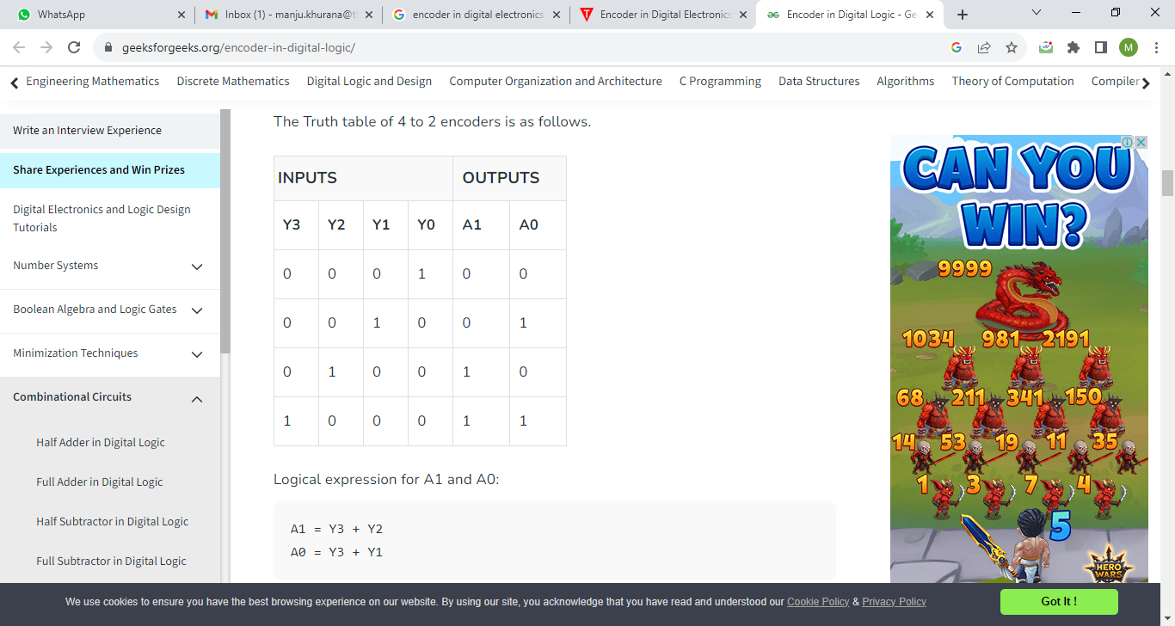
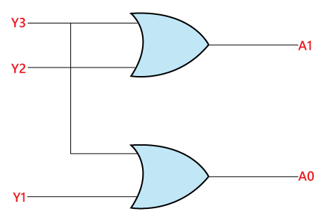
4 to 2 line Encoder
Block Diagram:
Truth Table:
Logical circuit:
The logical expression of the term A₀ and A₁ is as follows:
A₁=Y₃+Y₂ A₀=Y₃+Y₁

Slide 12
8 to 3 line Encoder
The 8 to 3 line Encoder is also known as Octal to Binary Encoder. In 8 to 3 line encoder, there is a total of eight inputs, i.e., Y₀, Y₁, Y₂, Y₃, Y₄, Y₅, Y₆, and Y₇ and three outputs, i.e., A₀, A₁, and A₂. In 8-input lines, one input-line is set to true at a time to get the respective binary code in the output side. Below are the block diagram and the truth table of the 8 to 3 line encoder.

Slide 13
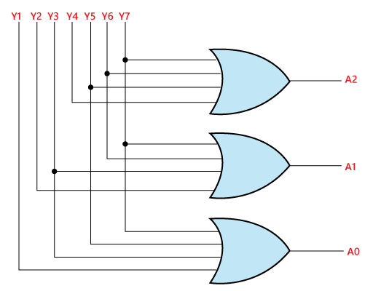
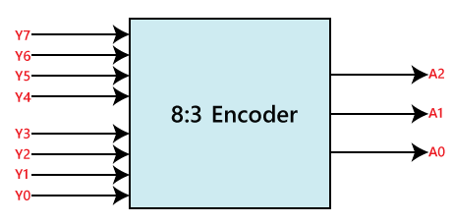
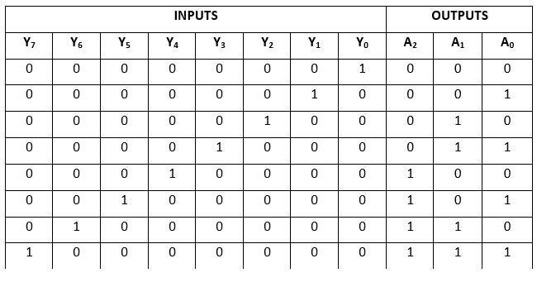
8 to 3 line Encoder
Block Diagram:
Truth Table:
Logical circuit:
The logical expression of the term A₀, A₁, and A₂ are as follows:
A₂=Y₄+Y₅+Y₆+Y₇ A₁=Y₂+Y₃+Y₆+Y₇ A₀=Y₇+Y₅+Y₃+Y₁

Slide 14


